Slide 1
Crop Production Data in India

Slide 2
01
Project Overview
02
Project Dashboard
CONTENTS
03
Insights

Slide 3
01
Project Overview
This dataset provides a huge amount of information on crop production in India ranging from several years. Based on the Information the ultimate goal would be to predict crop production and find important insights highlighting key indicators and metrics that influence the crop production.

Slide 4
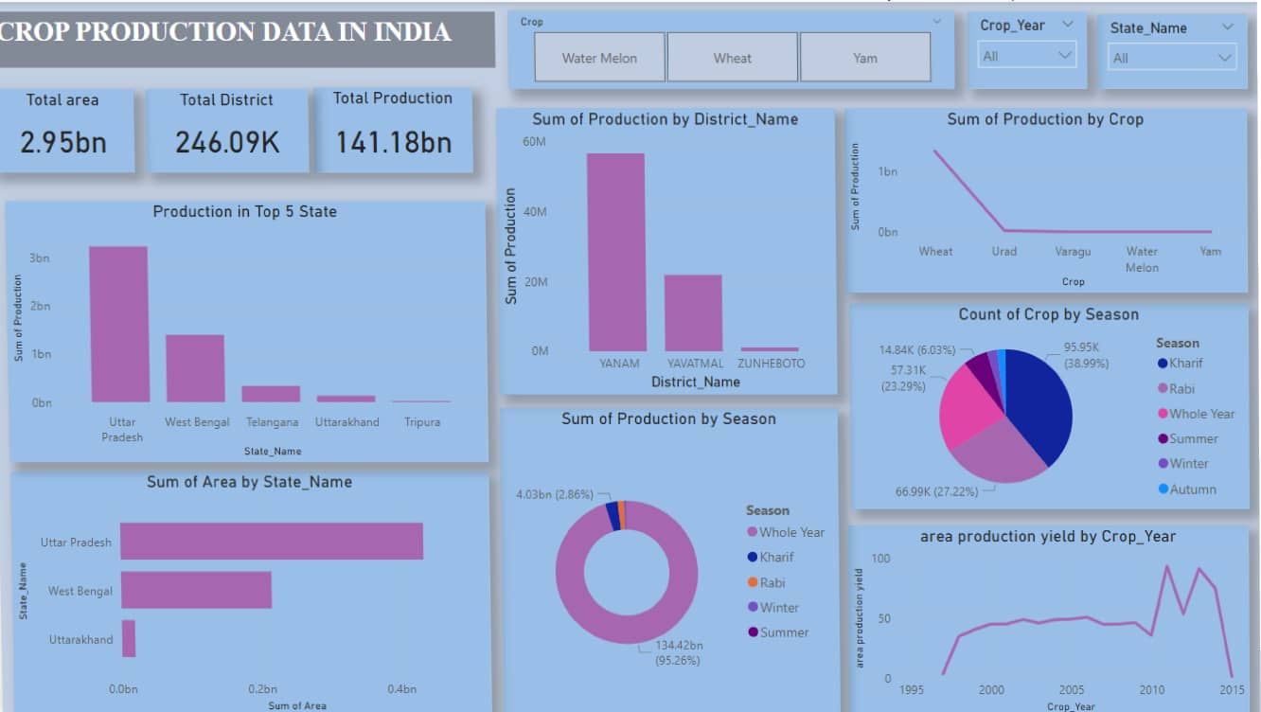
02
Project Dashboard

Slide 5
03
Insights
Top 3 crops as per Production in India
Water melon
Wheat
Yam
Total production of Water melon is Highest Among All Crops
Rajsthan is having Highest Production and Cultivation area among all state Maximum Production of Water melon Comes When It Sown in Whole Year Season

Slide 6
03
Insights
Top 3 Districts in production and cultivation area is Yanam, Yavatmal and Zunheboto
Kranatka is having highest counts of Crops but maximum production comes from other state lowest variety of crops belong from Chandigarh

Slide 7
THANK YOU

